Slide 1






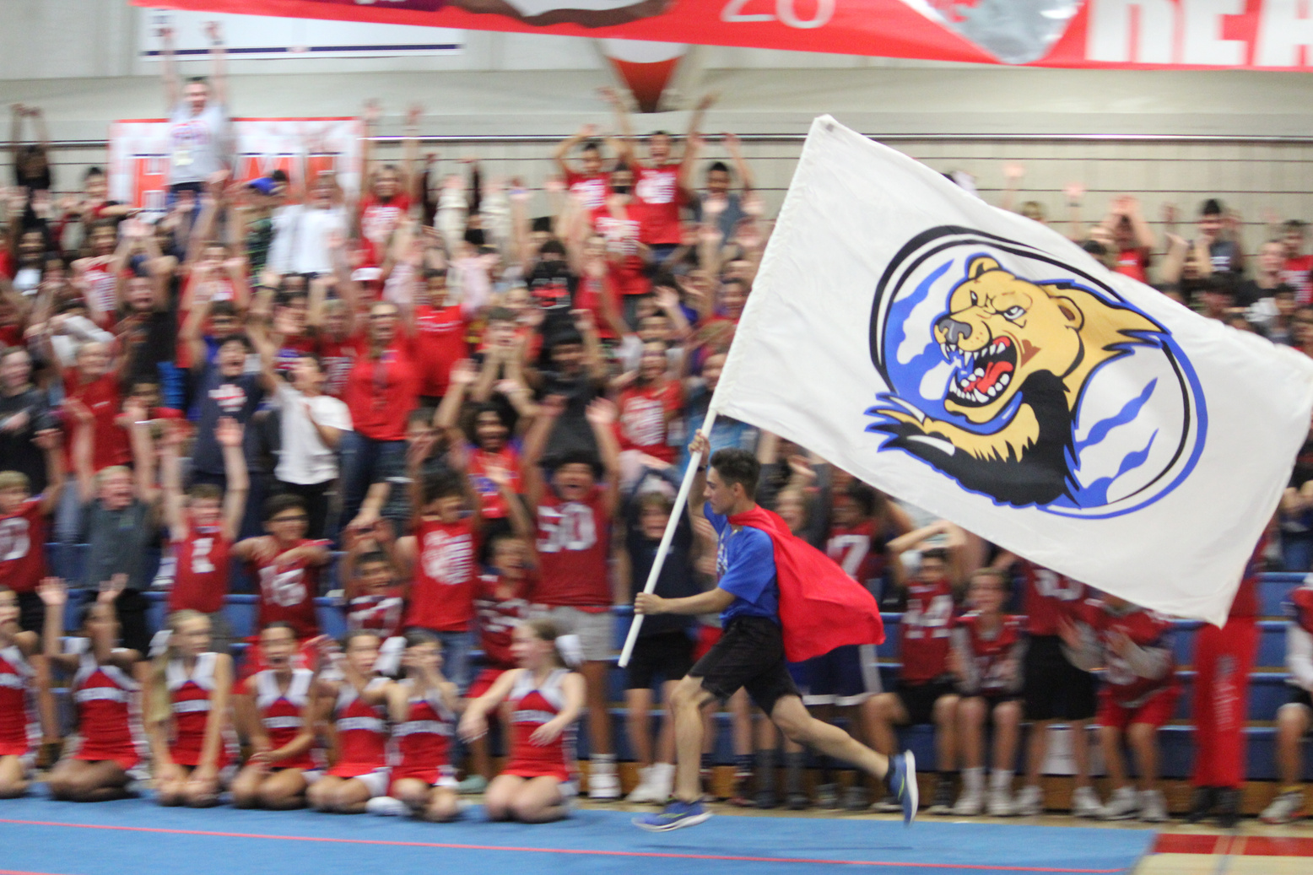


Alta Sierra Intermediate
SEMESTER 2 SUCCESS NIGHT
January 24, 2024
Visit Our Website
altasierra.cusd.com

Slide 2

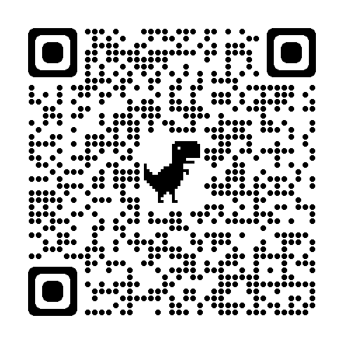

Pre-Survey
Please use your phone to scan the QR code and complete the Pre-Survey questions.

Slide 3
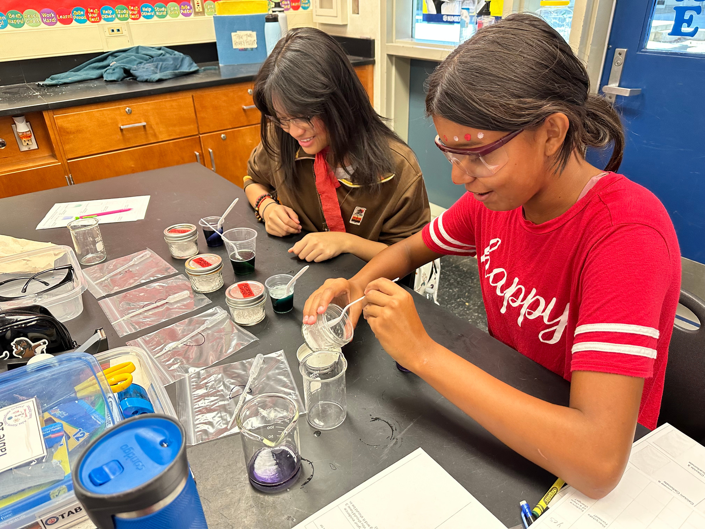

Get to Know You
Introduce yourself and how many students you have enrolled in Bear Nation?
What does your student most enjoy about attending Alta Sierra?
In what areas do you feel your student needs the most support?

Slide 4





Parent Connect
Download the App
Connect App to CUSD
Login within the App
View Your Student’s Grades
On your app store search “Q Parent Connect” to download.
Once downloaded, enter California in the state field, Fresno in the county field then choose Clovis USD as your district.
Within the app, click the login button in the upper right of the screen and use your same PIN/Password to login.
To view your student’s current grades, select Assignments from the menu choices. Semester 1 final grades are listed on the Marks tab.

Slide 5






My student’s grades are not where I hoped they would be…What should my next steps be?
Email the Teacher
After School Labs
Communicating your concerns or asking questions about your student’s grades should always start with the teacher. All email addresses are located on the ASI website.
Have your student attend After School Labs Tuesday-Thursday from 3:30-5:30 for additional help with homework or missing assignments.
Check Parent Connect Weekly
Reach out to their Counselor
Staying up to date with your student’s weekly assignment scores and quizzes/test grades allows you the opportunity to help your student not fall behind and take advantage of retake or late turn-in processes.
If your student is not succeeding in multiple classes, reach out to their counselor to discuss possible intervention courses during the school day.

Slide 6
My student’s grades are not where I hoped they would be…What should my next steps be?
After School Labs: 3:30 - 5:30 p.m.
Tuesday
AB Lab
Wednesday
Math Lab
Thursday
Science Lab
7th Grade
Room 209
Mrs. Albee
8th Grade
Room 303
Ms. Elia
7th Grade
Room 112
Ms. Chang
8th Grade
Room 604
Mrs. Zunich
7th Grade
Room 403
Mrs. Burdine
8th Grade
Room 101
Mrs. Colunga
Late Bus Available: Departs at 5:35 p.m.

Slide 7

GPA Calculation Activity

Slide 8

Why do grades matter?
  Co-Curricular Participation
  Registration Opportunities
  Remedial Summer School
  Grades Determine Credits at Buchanan High School
    A= Credits
    B= Credits
    C= Credits
    D= Credits/Retake Course
    F= No Credits/Retake Course

Slide 9
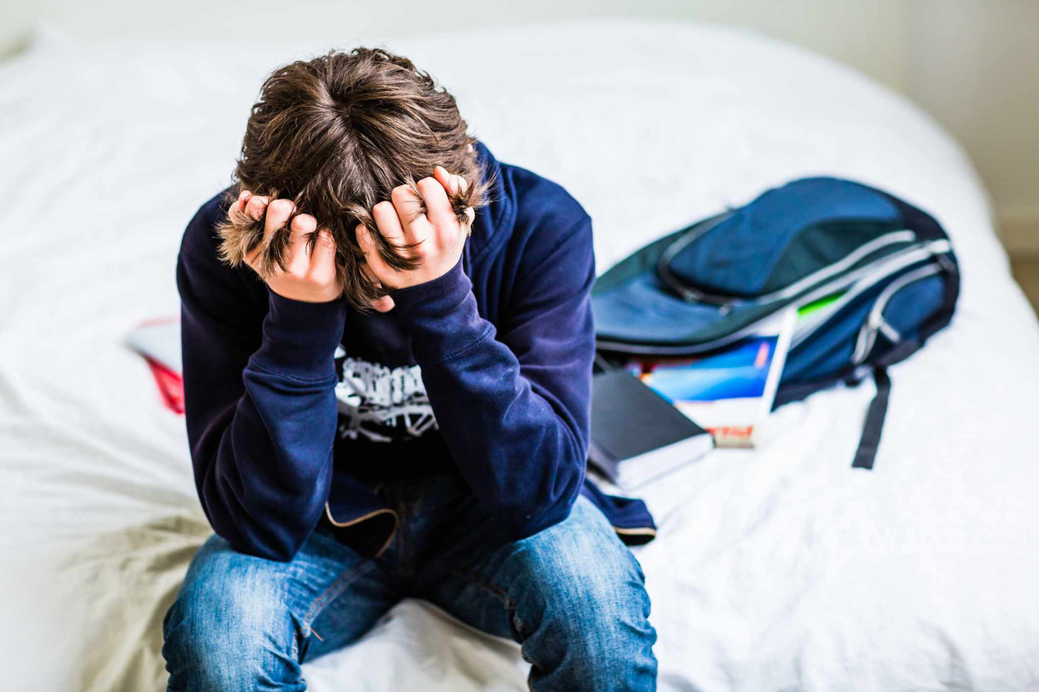
My student is struggling emotionally in middle school…Who should I contact?
Reach out to your student’s counselor to get them connected to our on-campus resources.
Mackenzie Mennucci
Last Names A-K
mackenziemennucci@cusd.com
(559) 327-3576
Meghan Tenney
Last Names L-Z
meghantenney@cusd.com
(559) 327-3518

Slide 10





Social-Emotional Supports On Campus
Clovis Support Intervention (CSI)
Mental Health Support Provider
Confidential support groups led by trained staff
Buchanan Area staff member on campus two days a week.
BHS Peer Counselors
Additional Resources
Trained high school students who can provide one-on-one support
Counselors can also refer students to additional resources on campus as needed.

Slide 11
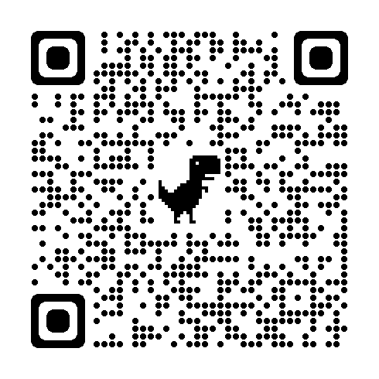
Post-Survey
Please use your phone to scan the QR code and complete the Post-Survey questions and provide any feedback on tonight’s presentation.
Thank you for joining us tonight!

